Slide 1
CONTACTOR CHECKOUT
PROCEDURE

Slide 2
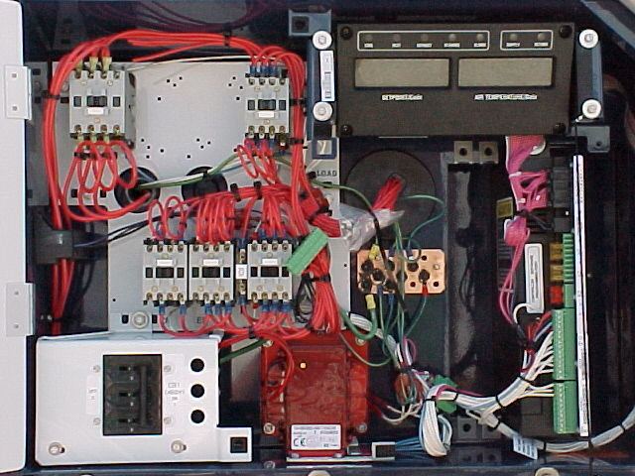

Slide 3
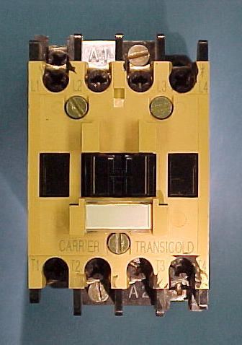

Slide 4
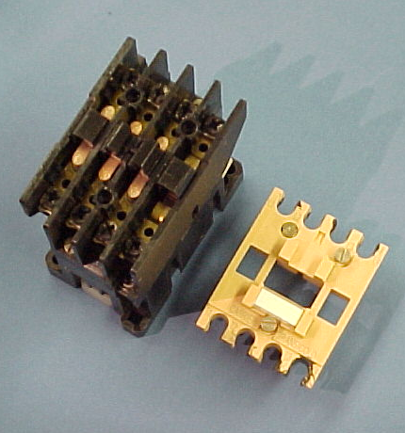

Slide 5
PROPERLY OPERATING CONTACTOR
TH
A1
KA3
L1
L2
L3
L1 - L2 = 460V
L1 - L3 = 460V
L2 - L3 = 460V
T1
T2
T3
HR
T1 - T2 = 460V
T1 - T3 = 460V
T2 - T3 = 460V
HEATER CONTACTOR
A2
A1 - TP9 = 24 VAC
L1 - T1 = 0V
L2 - T2 = 0V
L3 - T3 = 0V
A2 - TP9 = 0 VAC
COIL RESISTANCE = 4.0Ω

Slide 7
OPEN CONTACT
TH
A1
KA3
L1
L2
L3
L1 - L2 = 460V
L1 - L3 = 460V
L2 - L3 = 460V
T1 - T2 = 460V
T1 - T3 = 180V
T2 - T3 = 180V
T1
T2
T3
HR
HEATER CONTACTOR
A2
Closed contacts
Closed contacts
Open contacts
L1 - T1 = 0V
L2 - T2 = 0V
L3 - T3 = 460V
A1 - TP9 = 24 VAC
A2 - TP9 = 0 VAC
COIL RESISTANCE = 4.0Ω

Slide 8
OPEN GROUND
TH
A1
KA3
L1
L2
L3
L1 - L2 = 460V
L1 - L3 = 460V
L2 - L3 = 460V
T1
T2
T3
HR
T1 - T2 = 0V
T1 - T3 = 0V
T2 - T3 = 0V
HEATER CONTACTOR
A2
A1 - TP9 = 24 VAC
A2 - TP9 = 24 VAC
COIL RESISTANCE = 4.0Ω
A2 - TP9 = 0.LΩ

Slide 9
OPEN COIL
TH
A1
KA3
L1
L2
L3
L1 - L2 = 460V
L1 - L3 = 460V
L2 - L3 = 460V
T1
T2
T3
HR
T1 - T2 = 0V
T1 - T3 = 0V
T2 - T3 = 0V
HEATER CONTACTOR
A2
A1 - TP9 = 24 VAC
A2 - TP9 = 0.0 VAC
COIL RESISTANCE = 0.LΩ

